Slide 1
Word problems
Inclined plane

Slide 2
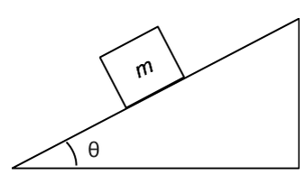

Problem 1.
An object moves on a 30° inclined plane downwards.
The surface is frictionless. Find the acceleration.
Find the acceleration if $μ_{k}$=0.2.

Slide 3
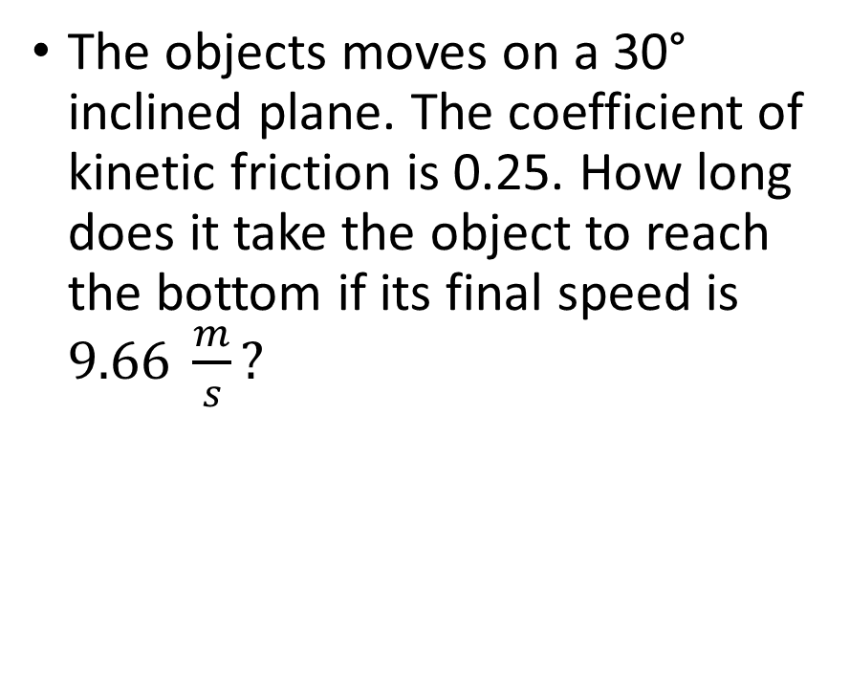
Problem 2.
The objects moves on a 30° inclined plane. The coefficient of kinetic friction is 0.25. How long does it take the object to reach the bottom if its final speed is $9.66 \frac{m}{s}?$

Slide 4
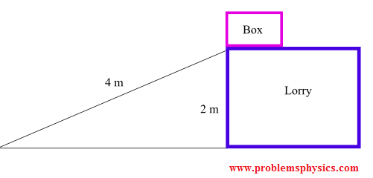
Problem 3.
A 100 Kg box is to be lowered at constant speed down an inclined plane 4 meters long from the back of a lorry 2 meters above the ground. The coefficient of kinetic friction is equal to 0.45. What is the magnitude of the force Fa to be applied parallel to the inclined plane to hold back the box so that it is lowered at constant speed?

